Slide 1

Disease prediction model : diabetes

Slide 2
ABOUT THE MODEL
Purpose Of The Model: The goal of the model is to predict the presence of diabetes in patients based on diagnostic measurements.
Application In Machine Learning: A diabetes prediction model facilitates early diagnosis, enabling preventative healthcare and improved management for at-risk individuals.

Slide 3
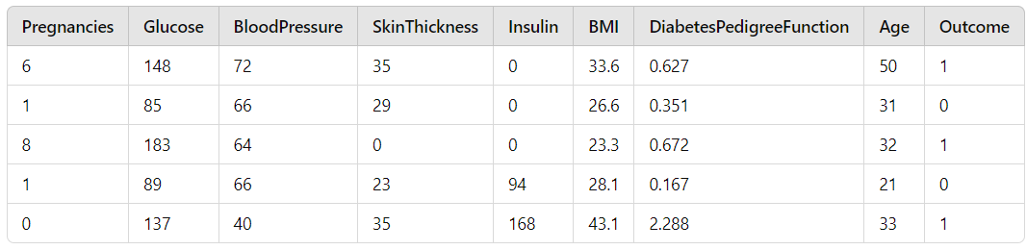
Dataset used
The dataset for the diabetes prediction model was obtained from Kaggle, enabling early detection and improved management of diabetes risks.
Features description:
Pregnancies: number of times pregnant
Glucose: plasma glucose concentration over 2 hours in an oral glucose tolerance test
Bloodpressure: diastolic blood pressure (mm hg)
Skinthickness: triceps skin fold thickness (mm)
Insulin: 2-hour serum insulin (mu U/ml)
BMI: body mass index (weight in kg/(height in m)^2)
Diabetespedigreefunction: diabetes pedigree function (a function which scores likelihood of diabetes based on family history)
Age: age (years)
Outcome: class variable (0 or 1) where 1 indicates diabetes and 0 indicates no diabetes

Slide 4

Data preprocessing
Handling Missing Values: Replacing zeroes (where they are biologically implausible) in features like glucose, bloodpressure, skinthickness, insulin, and BMI with appropriate statistics (mean/median) of each column.
Data Scaling: Scaling the data to normalize the feature magnitude for effective model performance.
Data Splitting: Splitting the data into 80% training and 20% testing sets to evaluate the model's performance.

Slide 5
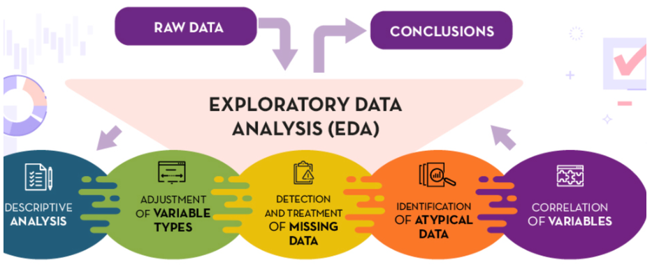
EXPLORATORY DATA ANALYSIS (EDA)
Correlation Matrix: Examine the relationships between different features to understand their influence on diabetes outcome.
Receiver Operating Characteristic (ROC) Curve: Evaluate a classifier's performance by plotting true positive rate against false positive rate.
Confusion Matrix: Quantify the accuracy of a classification model by comparing predicted and actual labels.

Slide 6
ALGORITHM USED
K – Nearest Neighbors (KNN) was chosen for the Diabetes Prediction Model due to its efficacy in capturing intricate patterns in physiological data relationships.
Simplicity and Intuitiveness: KNN is simple and intuitive, making it a practical choice for initial baseline models.
Non-Linear Boundaries: Handles non-linear decision boundaries effectively, accommodating complex relationships between variables.
No Assumption About Data: Assumes no specific data distribution, increasing its versatility in real-world applications.
Effectiveness with Small Datasets: Performs well with smaller datasets where more complex models might not be necessary.

Slide 7
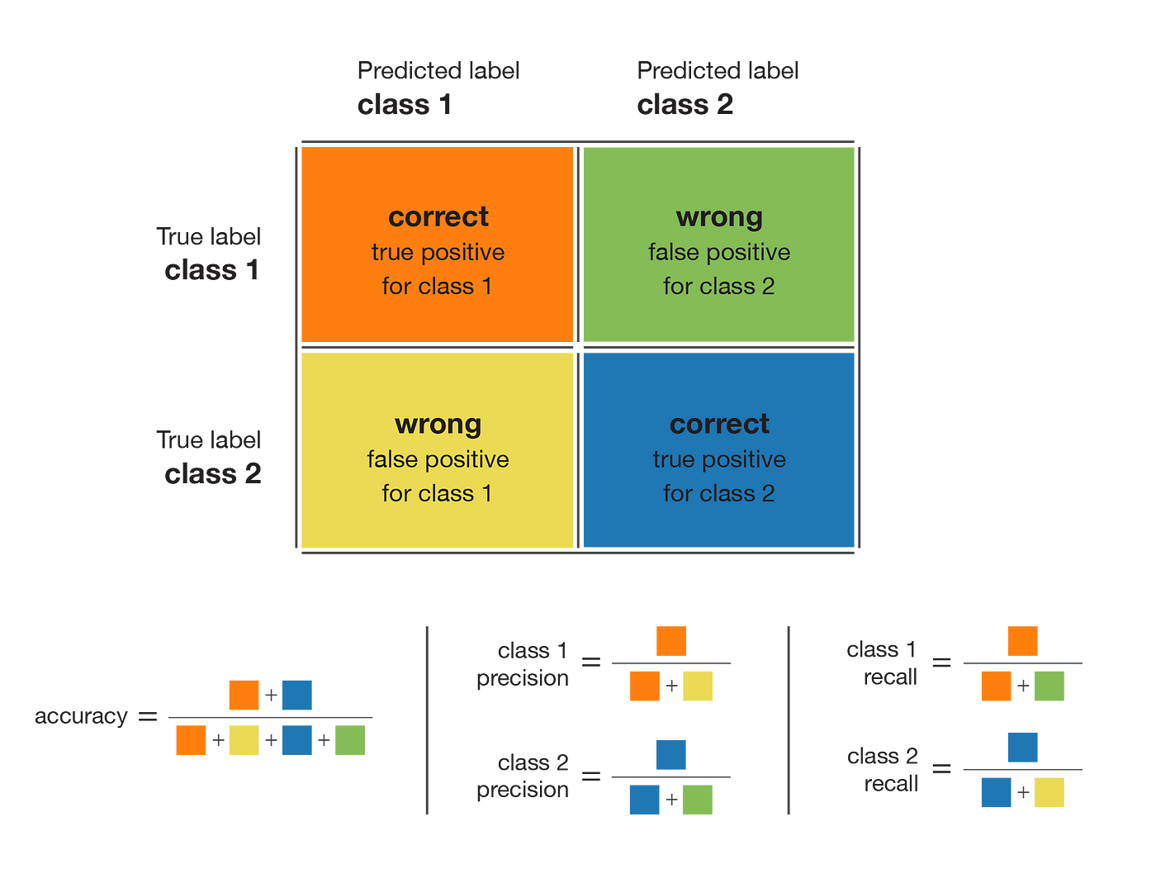
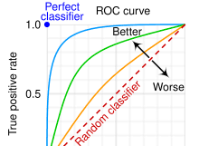
Model Performance
Test Accuracy: Indicates approximately 77.27% correctness in diabetes status predictions on test data.
Confusion Matrix: Evaluates true and false positives and negatives, crucial for diagnostic accuracy.
ROC Curve: Assesses model performance across various classification thresholds, optimizing sensitivity and specificity.
Correlation Matrix: Reveals feature relationships, guiding feature importance and model interpretation for diabetes.

Slide 8
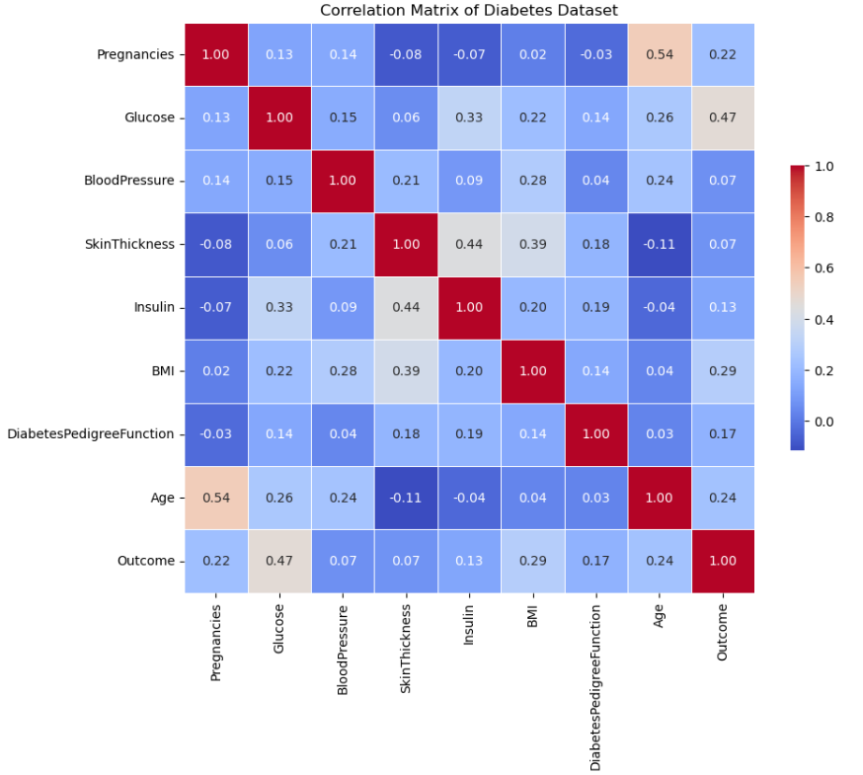
Correlation matrix INTERPRETATION
Glucose and Outcome (0.47): Strong correlation shows high glucose levels increase diabetes likelihood significantly.
BMI and Outcome (0.29): Moderate correlation identifies obesity as a notable diabetes risk factor.
Age and Outcome (0.24): Older age correlates moderately with increased diabetes risk.
Insulin and SkinThickness (0.44): Reflects physiological link between insulin resistance and body fat.
Pregnancies and Age (0.54): Strong correlation suggests more pregnancies occur with increasing age.
The correlation matrix effectively highlights key relationships, guiding feature selection and enhancing predictive accuracy for the diabetes outcome model.

Slide 9
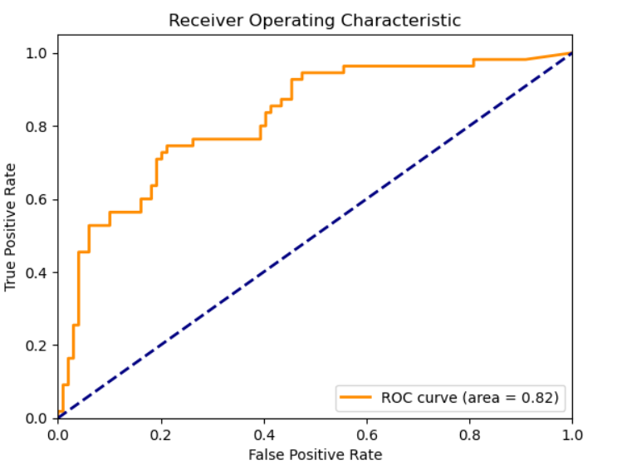
ROC CURVE INTERPRETATION
Area Under Curve (AUC) 0.82: Indicates good model performance, reliably distinguishing between classes.
Curve Above Baseline: The ROC curve significantly above the diagonal suggests better than random predictions.
Initial Steep Rise: Rapid increase at lower false positive rates implies high sensitivity.
Plateau Toward Top-Right: Suggests a threshold beyond which gains in true positive rate diminish.
Decision Threshold Tuning: Potential for fine-tuning decision thresholds to optimize balance between sensitivity and specificity.
The ROC curve with an AUC of 0.82 demonstrates robust model performance in distinguishing between diabetic and non-diabetic patients effectively.

Slide 10
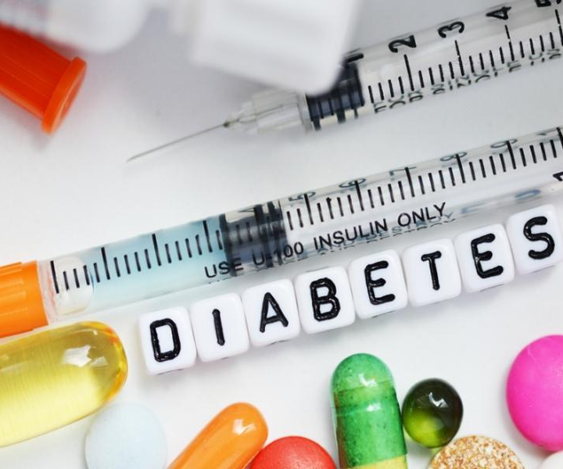
Thank you

